Slide 1






FOODTRENDS UNDERSTANDING CUSTOMER PREFERENCES IN FB
Batch 11 (Team-B)
Submitted By: Garvit Rajpoot
Submitted To: Nityasree Ma’am

Slide 2

PROJECT OBJECTIVE & DESCRIPTION
Objective:
Description:
To analyze over 138,000 transaction records and transform raw data into a strategic decision-support system. The primary objective is to bridge the gap between Customer Demand and Operational Supply by moving beyond simple reporting to Root Cause Analysis. This involves pinpointing specific logistics bottlenecks, optimizing menu pricing strategies to boost Average Order Value (AOV), and identifying retention risks within the customer base to drive sustainable revenue growth.
In the competitive FB landscape, operational efficiency is directly tied to profitability. This project deploys Microsoft Power BI to engineer a full-scale analytical solution. Starting with raw data ingestion and ETL transformation, we constructed a Star Schema data model to simulate real-world business scenarios. The final dashboard ecosystem focuses on Menu Optimization (identifying "Cash Cows" vs. "Dogs"), Logistics Performance, and Customer Sentiment, providing stakeholders with the actionable intelligence needed to reduce churn and increase Average Order Value (AOV).
01

Slide 3
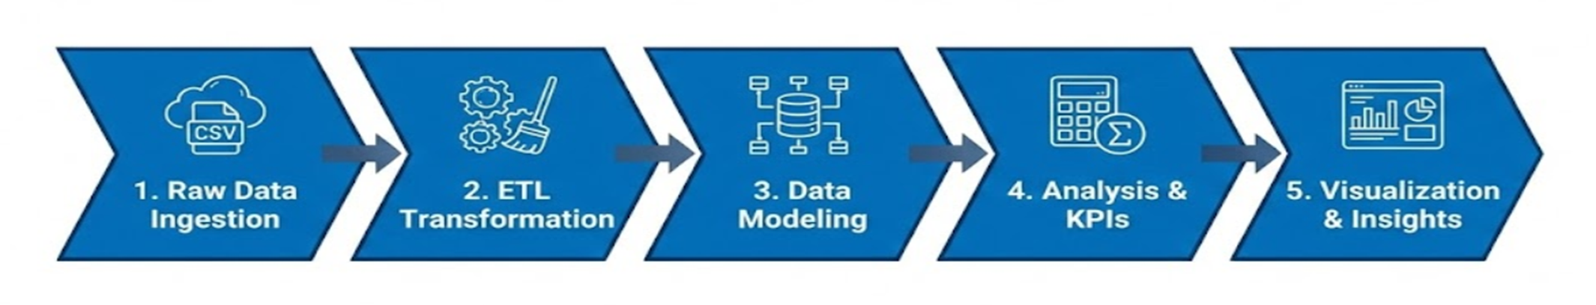
SYSTEM DESIGN & WORKFLOW
Ingested 138k+ transaction records from Kaggle CSV datasets.
Consolidated data across Orders, Restaurants, and Users tables.
leveraged Power Query to clean null values and remove duplicates.
Standardized inconsistent entries (e.g., city names) for data integrity.
Architected a Star Schema model for optimized performance.
Established active One-to-Many relationships between Fact and Dimension tables.
Engineered custom DAX measures to calculate Churn Rate, AOV, and Delay %.
Created Time Intelligence functions to track Month-over-Month (MoM) growth.
Designed 7 interactive dashboards with drill-through navigation.
Visualized key trends in Menu Profitability, Logistics, and Customer Sentiment.
02

Slide 4
PROJECT EXECUTION MILESTONES
Milestone 1: Data Discovery
Milestone 3: Customer Intelligence
Imported raw CSVs from Kaggle, handled missing data, and built the foundational Data Model.
Created "Demographics" and "Segmentation" views to analyse Veg/Non-Veg trends and customer profiles.
1
2
3
4
Milestone 2: Core Reporting
Milestone 4: Advanced Strategy
Developed "Sales Overview" (£275K Revenue) and "Menu Analysis" dashboards for initial insights.
Finalised "Logistics Command Centre" (tracking 39% SLA) and "Sentiment Analysis" for strategic planning.
03

Slide 5




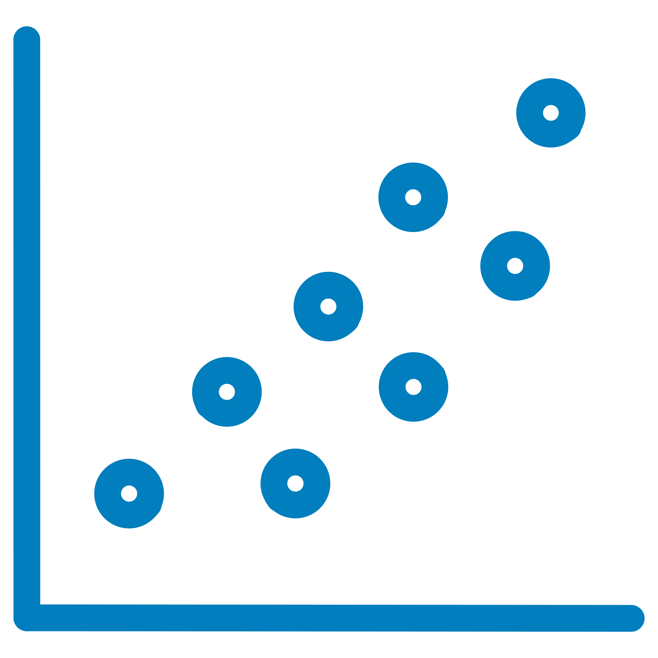
TOP VISUALISATIONS USED
Decomposition Tree
Ribbon Chart
Scatter Plot
Used for Root Cause Analysis to trace negative feedback down to specific cuisines (e.g., North Indian).
Employed to track rank changes in restaurant popularity and performance over time.
Utilised to correlate "Total Quantity" vs. "Profit" to identify high-performer menu items.
04

Slide 6
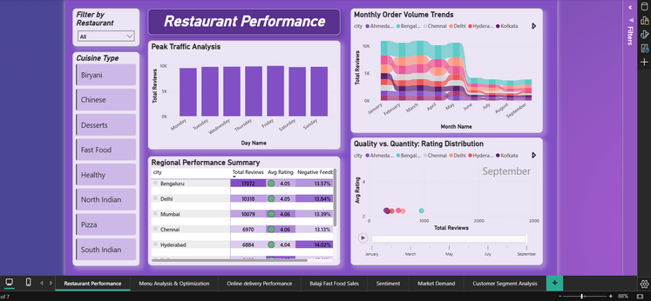
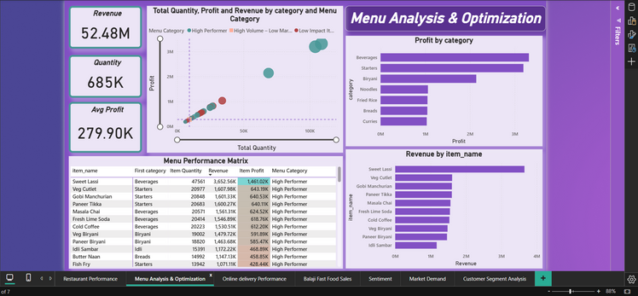
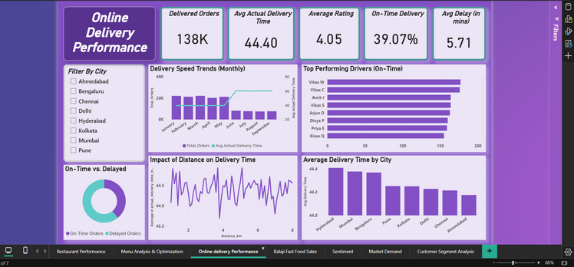
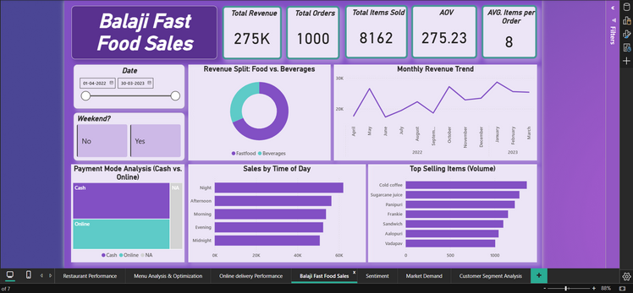
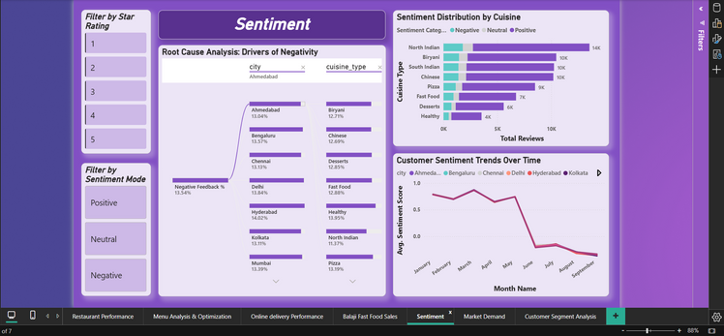
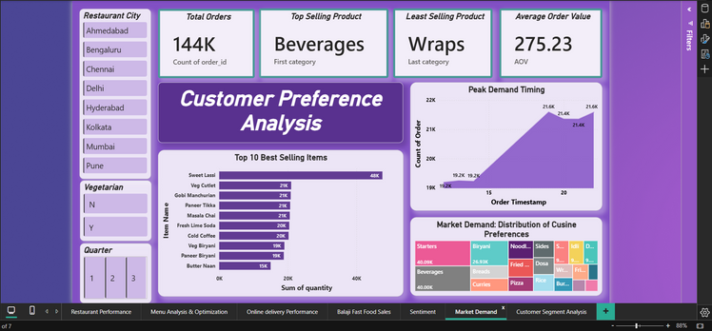
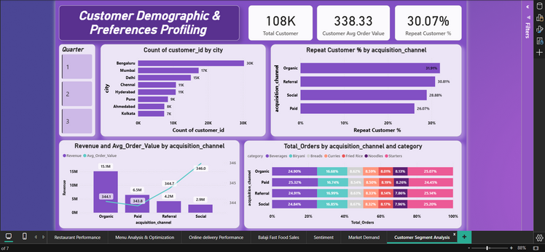
DASHBOARD SHOWCASE
Restaurant Performance: Tracking peak traffic and rank shifts.
Menu Analysis & Optimisation: Matrix identifying high-profit vs. low-margin items.
Online Delivery Performance: Monitoring the critical 39% On-Time Delivery Rate.
Balaji Fast Food Sales: Tracking 275K revenue trends and hourly sales spikes.
Sentiment Analysis: AI-driven root cause of customer complaints.
Market Demand (Customer Preference): Identifying peak demand hours (8 PM - 10 PM).
Customer Segment Analysis: Profiling the 52% Organic user base and repeat customer rates.
05

Slide 7
CHALLENGES & RESOLUTIONS
Challenge 1: Visual Performance Lag
Challenge 2: Inactive Relationships
Plotting 138k individual points on a Scatter Plot caused system crashes.
Revenue visuals flat-lined due to disconnected tables, leading to inaccurate reporting.
Resolution:
Resolution:
Aggregated the data by "Restaurant Name" to optimise rendering speed and maintain system stability.
Rebuilt the Star Schema to ensure proper cross-filtering between Dimensions and Facts, restoring data integrity.
06

Slide 8



TECHNOLOGIES & SKILLS GAINED
This internship provided an invaluable opportunity to apply and enhance a diverse set of technical skills, utilising industry-standard tools to deliver a robust analytics solution.
Core Tech Stack
Key Skills Gained
Power BI Desktop
Data Modelling
Mastery in designing efficient Star Schema relationships for optimal performance.
Primary tool for data visualisation and report creation.
Power Query Editor
Advanced Analytics
Ability to create dynamic measures for SLA Adherence and Customer Retention metrics.
Essential for data extraction, transformation, and loading processes.
DAX
Soft Skills Development
Developed critical Data Storytelling abilities to present complex insights effectively to stakeholders and drive action.
Data Analysis Expressions for complex calculations and measures.
07

Slide 9
KEY BUSINESS INSIGHTS:
FUTURE ENHANCEMENTS:
Logistics is the Bottleneck: The 39% On-Time Delivery Rate is a critical operational failure. Immediate fleet expansion is required in Hyderabad and Mumbai to stop customer churn.
The "Organic" Engine: Organic users make up 52% of the customer base and show higher retention. Shift marketing to "Retention Rewards" for this loyal segment.
The Volume Trap: "Beverages" have low individual profit margins despite high volume. Implement "Combo Meals" to increase Average Order Value (AOV).
Row-Level Security (RLS): Implement security roles to restrict access, allowing Branch Managers to view only their specific City's data.
What-If Parameters: Add interactive sliders to simulate business scenarios (e.g., "If we discount Biryani by 10%, how much will Revenue increase?").
Mobile Layout Optimisation: Design a specific "Mobile View" of the Logistics Dashboard for Area Managers to monitor live fleet performance on their smartphones.
08

Slide 10
CONCLUSION, ACKNOWLEDGEMENT & REFERENCES
Conclusion:
Acknowledgement:
Operational Gap: The analysis reveals a critical disconnect between product strength and service execution. While the menu is highly profitable, a 39% delay rate in last-mile delivery is the primary bottleneck.
Customer Retention: Data indicates that speed, not price, is the strongest predictor of customer loyalty. Immediate restructuring of logistics SLAs is required to reduce churn among "Organic" users.
Business Impact: The project confirms that data-driven decision-making can transform raw numbers into actionable strategies for Menu Engineering and cost optimization.
I would like to express my heartfelt gratitude to:
Infosys Springboard Team for organizing this valuable internship opportunity.
My Mentor (Nityasree Ma’am)– for her continuous support and feedback.
My Teammates (Shashank, Vanshika) – for collaboration, encouragement, and insights.
This internship has been a significant step in my professional growth and technical journey.
References:
Infosys Springboard Virtual Internship Course Materials.
Microsoft Power BI Documentation.
Food Industry Logistics Case Studies.
Kaggle Dataset: Zomato Food Delivery Data.
09

Slide 11
THANK YOU
Questions & Discussion

